Slide 1




Emotional Expression & Speech Recognizer
BMI Final Project
Tushar Agashe, Shiyang Xin, Xiao Guo, Isaac Yeoh
Notes:
Shiyang

Slide 2
TABLE OF CONTENTS
Introduction & Background
Emotional Speech Model EDA
01
04
Facial Expression Model EDA
Emotional Speech Model Structure & Performance
02
05
Facial Expression Model Structure & Performance
03
06
Future Directions
Notes:
Shiyang

Slide 3
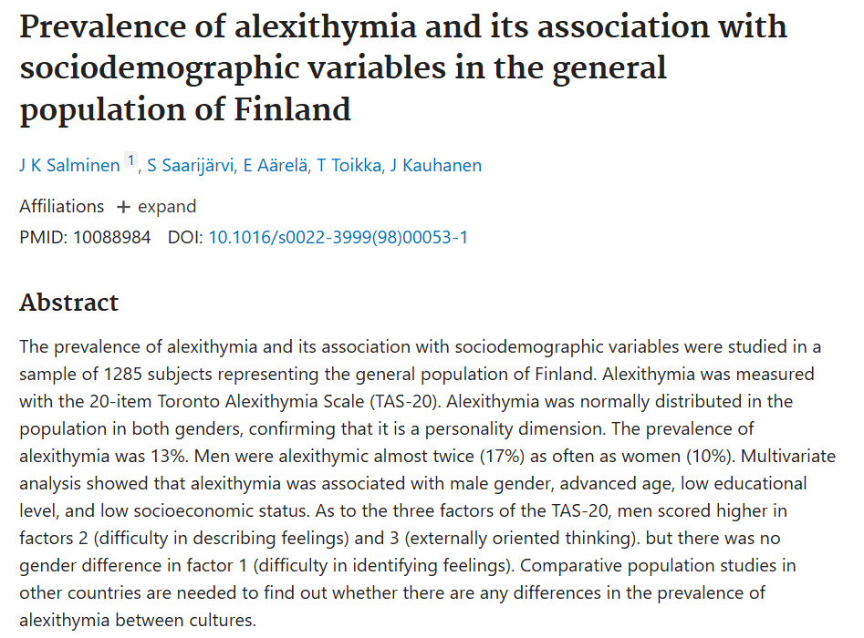
Problem
Alexithymia
Difficulties identifying feelings and emotions
Hard to distinguish between emotions and bodily sensations that relate to those emotions
No known conversational agents
Notes:
Isaac
We started our project due to a heavily under-researched symptom- Alexithymia. Alexithymia is when a person has difficulty experiencing, identifying, and expressing emotions. It is not a mental health disorder but has links with PTSD and other mental health conditions. A study conducted in 1999 showed that the prevalence of alexithymia was around 13%. However, there are very few tools that are readily available to help patients with this impairment.

Slide 4
Solution
“ Build out a system that processes both facial and speech-emotional data to further advance human-computer interactions ”
Notes:
Isaac
As such, we propose this as a solution. We intend to build out a system that processes both facial and speech emotional data to further advance human computer interactions to help individuals struggling with Alexithymia

Slide 5
Intended Overall System Architecture
From a video predict emotional state
For this project: build out two separate models and join them together
Image classifier
Audio classifier
Classify emotions and pick nodes that has the better scoring metric
AI Agent
Extract Facial Emotion Data
Image Emotional Classifier
Video Source
Predicted Emotion
Extract Emotional Speech Data
Audio Emotional Classifier
Notes:
Tushar

Slide 6
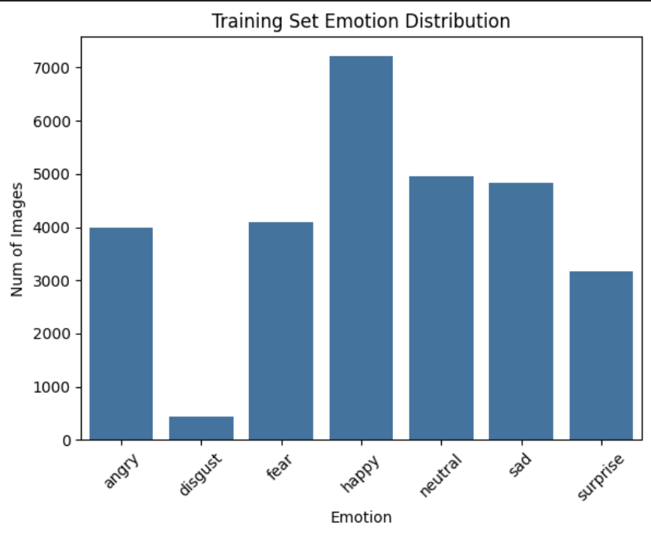
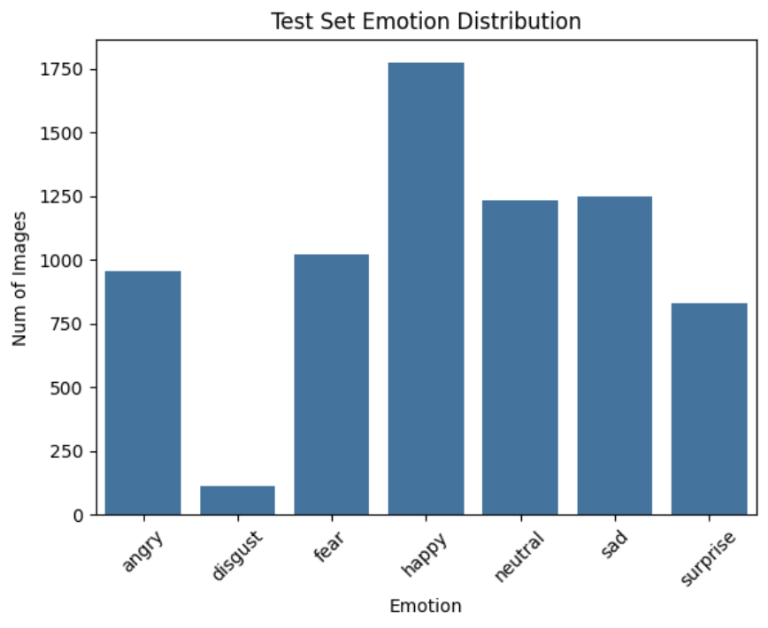
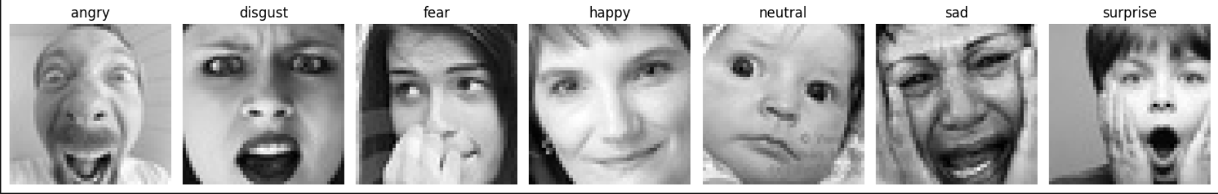
Facial Expression Model EDA
Training
Data source: FER-2013
Data format: 48x48 pixel grayscale images of faces
Statistical Summary:
Train:validate:Test=64:16:20
Examples:
 | Total | Angry | Disgust | Fear | Happy | Neutral | Sad | Surprise
Train+validate | 28709 | 3995 | 436 | 4097 | 7215 | 4965 | 4830 | 3171
Test | 7178 | 958 | 111 | 1024 | 1774 | 1233 | 1247 | 831
Test
Notes:
Xiao

Slide 7
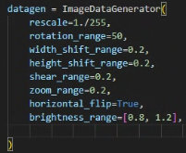
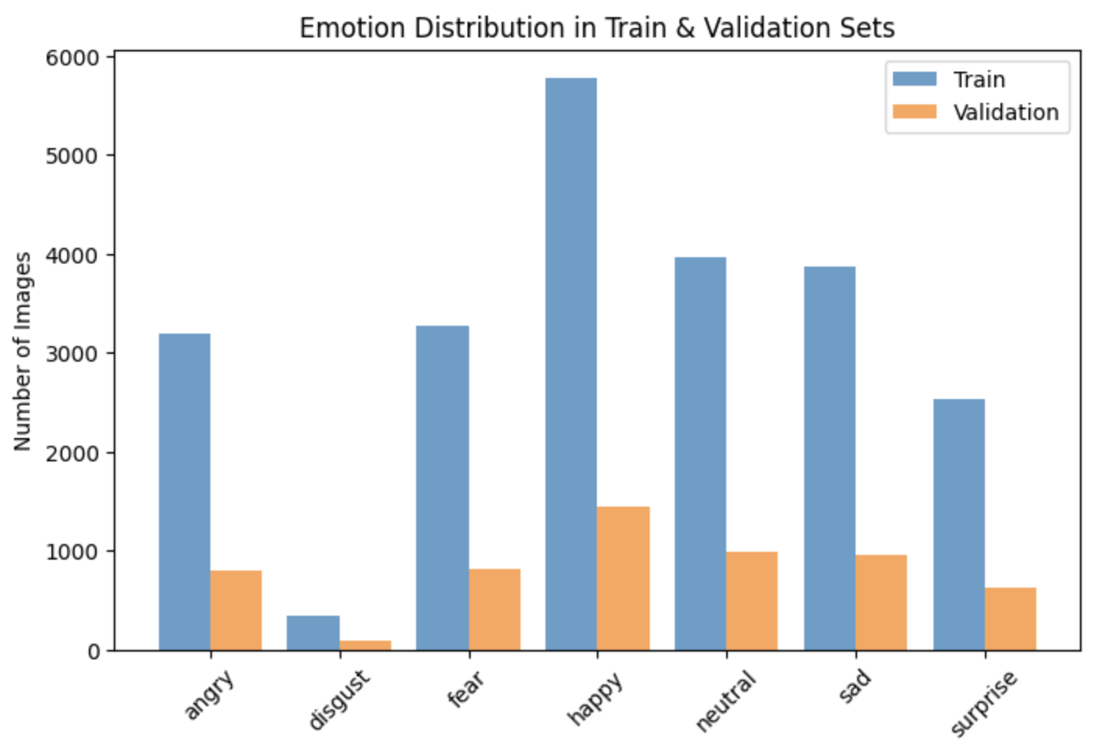
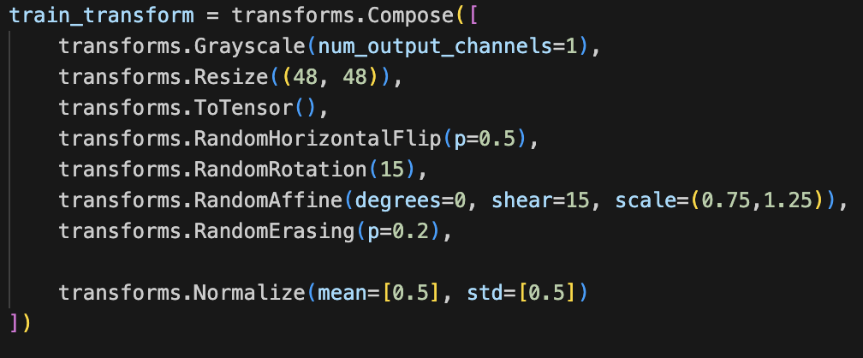
Facial Expression Model Augmentation
Data augmentation:
Using TensorFlow:
Using PyTorch:
Notes:
Xiao
we first prepared the dataset by splitting it into 80% training and 20% validation.
The bar chart shows the distribution of emotions in the dataset. We can see some class imbalance, particularly for emotions like 'disgust,' which is underrepresented.
To make our models more robust, we applied data augmentation using TensorFlow and PyTorch. Both approaches included transformations like rotation, flipping, scaling, and brightness adjustments. TensorFlow uses the ImageDataGenerator class to apply these augmentations dynamically. PyTorch uses the transforms module, which provides greater flexibility, such as grayscale conversion, random erasing, and more control over normalization."

Slide 8
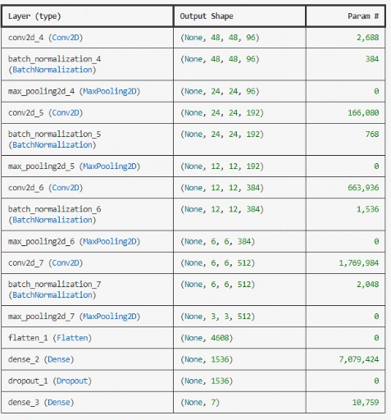
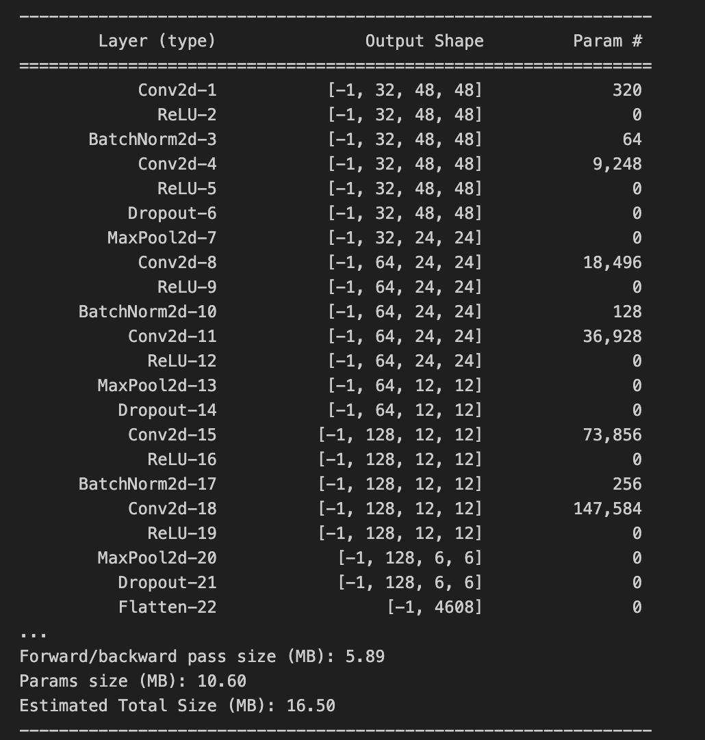
Facial Expression Model Structure
CNN-1 TensorFlow
CNN-2 PyTorch
Input
1 x 48 x 48
Input
1 x 48 x 48
512 neurons
256 neurons
Output
7 emotion classification
Output
7 emotion classification
Notes:
Shiyang: CNN. Xiao used 5 convolutional layers while I used 4. Different number of filters. Different parameters. for example. 96 vs. 32. Different epochs.
Xiao: The network begins with three convolutional blocks. The first layer extracts low-level features like edges and textures using 32 filters. We then apply batch normalization for stable learning and dropout to prevent overfitting. Each block has a max-pooling layer to progressively reduce the spatial size, allowing us to capture more abstract features as we go deeper. The second and third convolutional blocks increase the number of filters to 64 and 128, enabling the model to learn mid-level and high-level features, such as facial structures and expressions.
After feature extraction, the model flattens the 3D tensor into a 1D vector and passes it through three fully connected layers. The first has 512 neurons, the second has 256, and the final layer has 7 neurons corresponding to the emotion classes. ReLU activation ensures non-linearity, and dropout prevents overfitting. Finally, a softmax function produces the probability distribution over the seven emotions.
To improve stability, I applied batch normalization after key convolution layers and dropout throughout the model. This prevents overfitting and ensures the network generalizes well on unseen data.

Slide 9
FEM Hyperparameter Tuning
conv1_filters: 32 to 128 (step of 32)
conv2_filters: 64 to 256 (step of 64)
conv3_filters: 128 to 512 (step of 128)
conv4_filters: 256 to 512 (step of 128)
dense_units (512 to 2048, step of 512)
dropout_rate (0.3 to 0.7, step of 0.1)
learning_rate (choice of 0.001, 0.0005, or 0.0001)
aims to maximize validation accuracy with 10 different randomly-chosen hyperparameter combinations
Best hyperparameters
conv1_filters: 96
conv2_filters: 192
conv3_filters: 384
conv4_filters: 512
dense_units: 1536
dropout_rate: 0.60
learning_rate: 0.0001
Notes:
Shiyang Xin

Slide 10
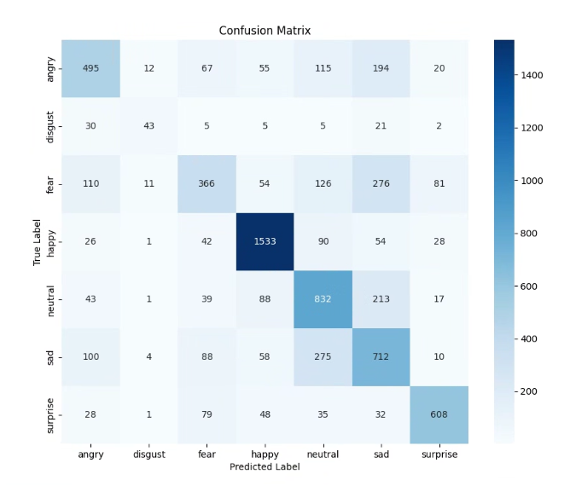
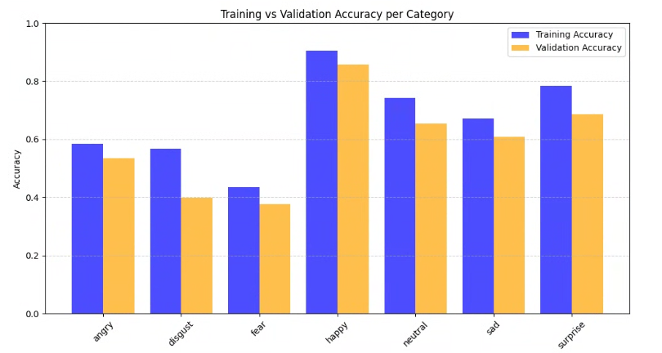
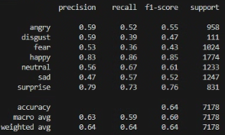
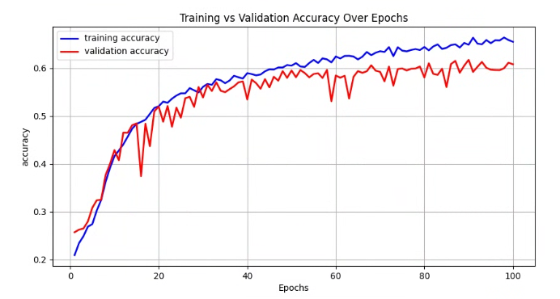
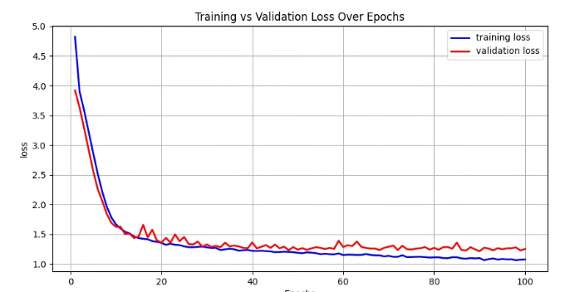
FEM-1 Performance
Notes:
Shiyang: replicate slide 11

Slide 11
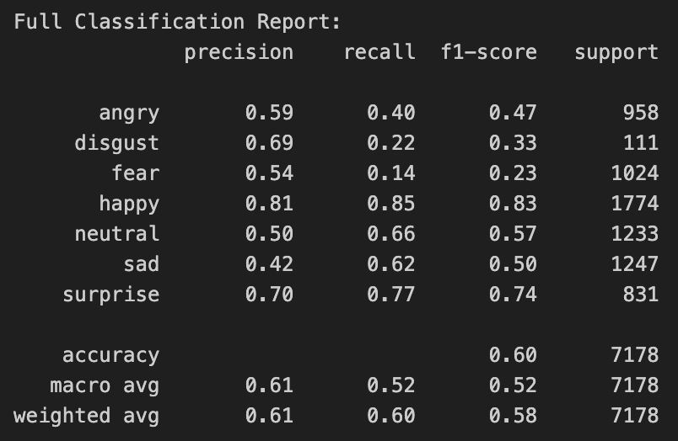
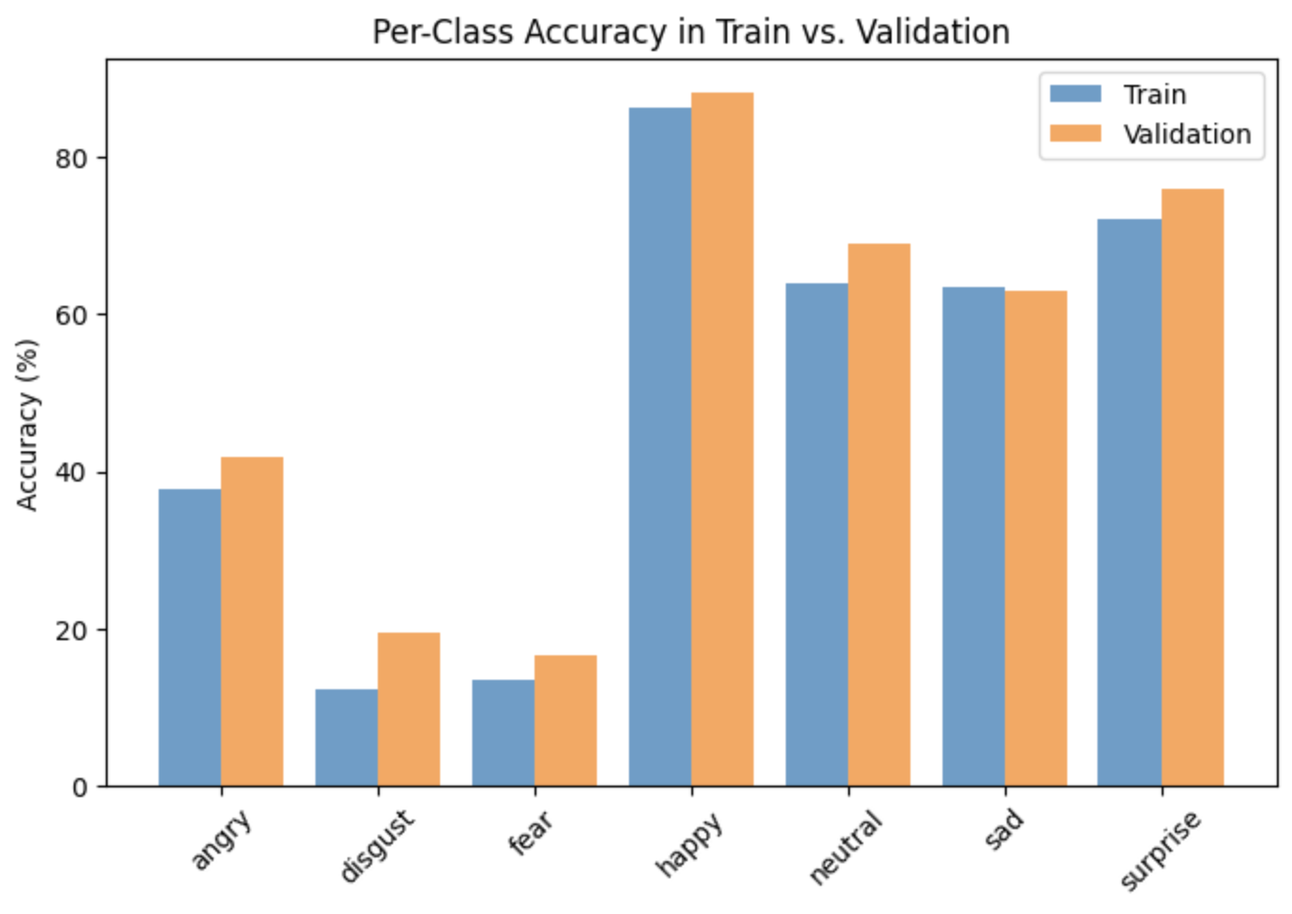
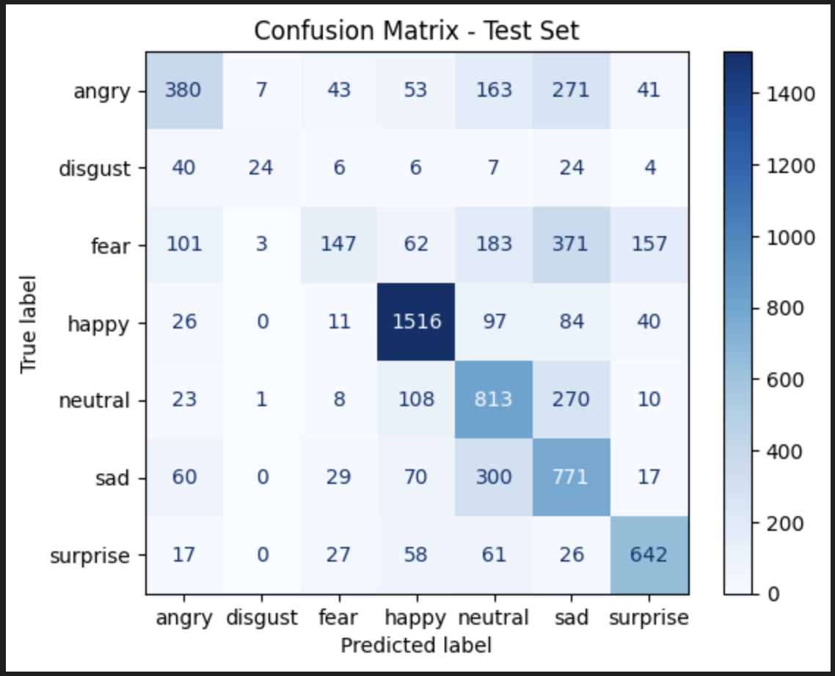
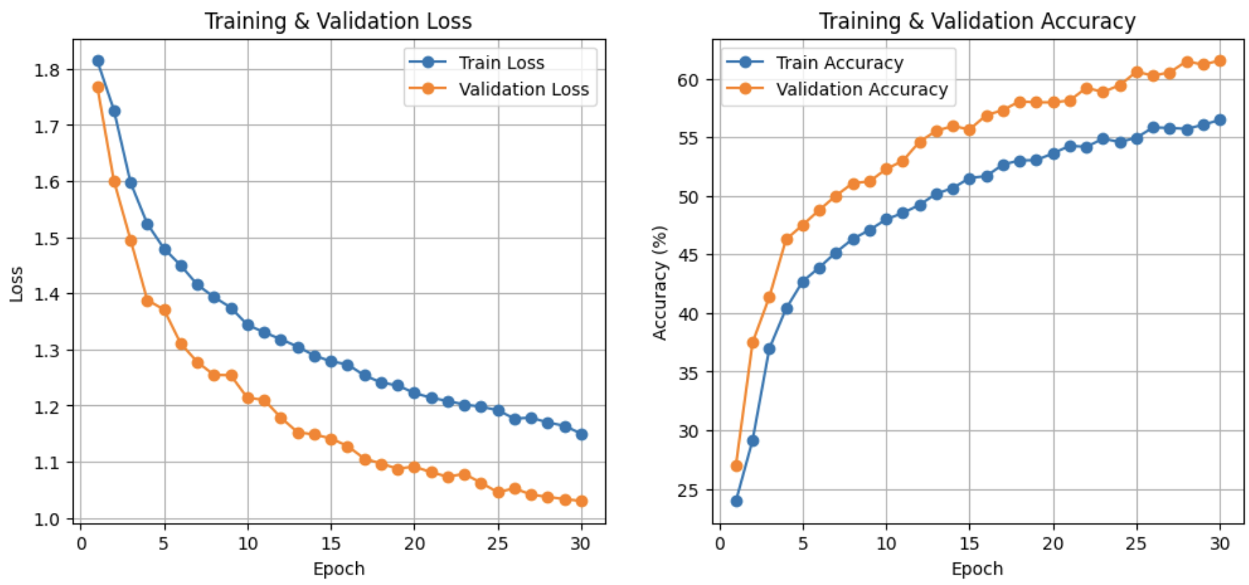
Facial Expression Model-2 Performance
Notes:
Xiao

Slide 12
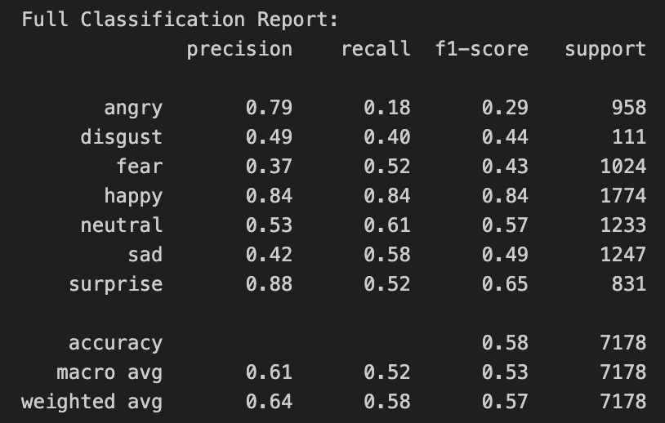
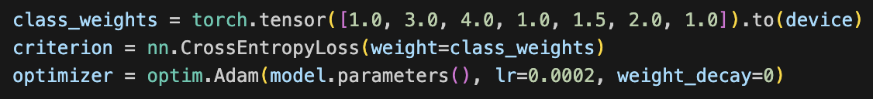
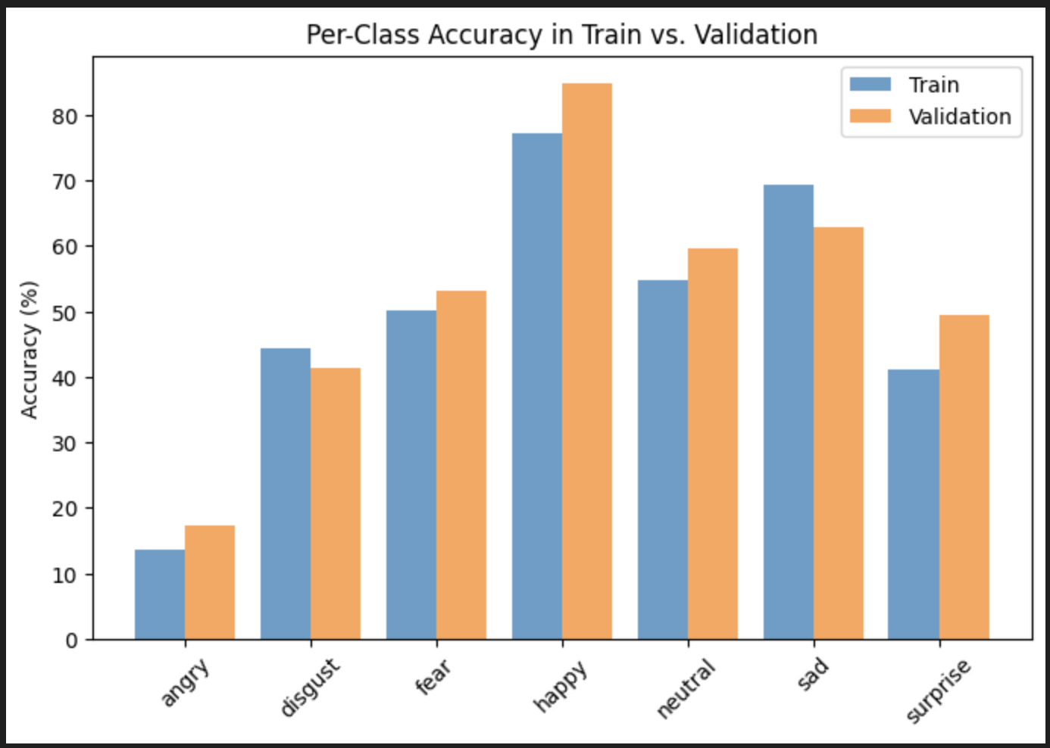
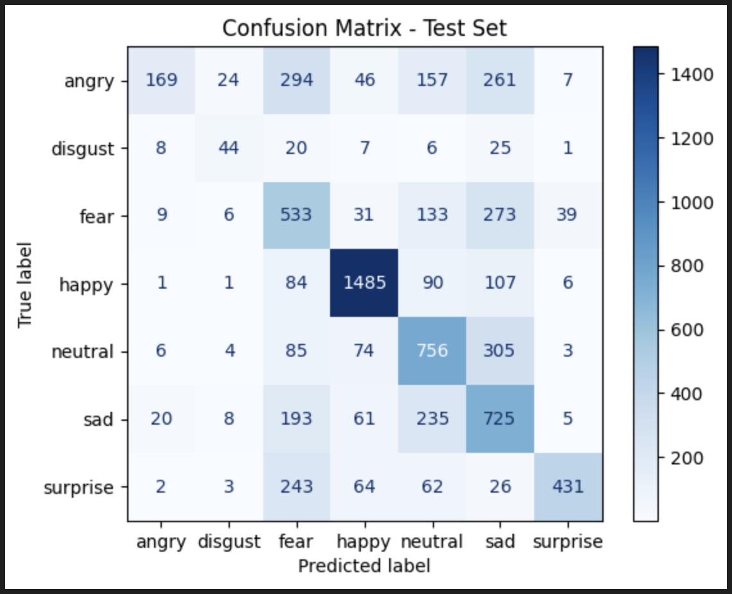
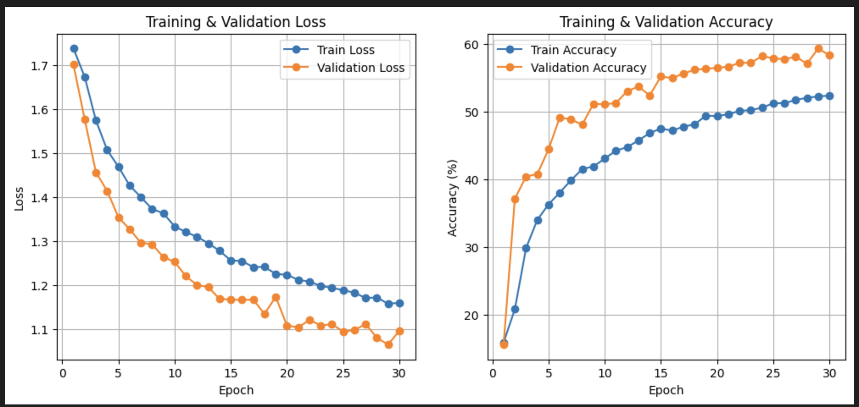
Facial Expression Model-2 Performance
-Weighted Loss
Notes:
Xiao

Slide 13
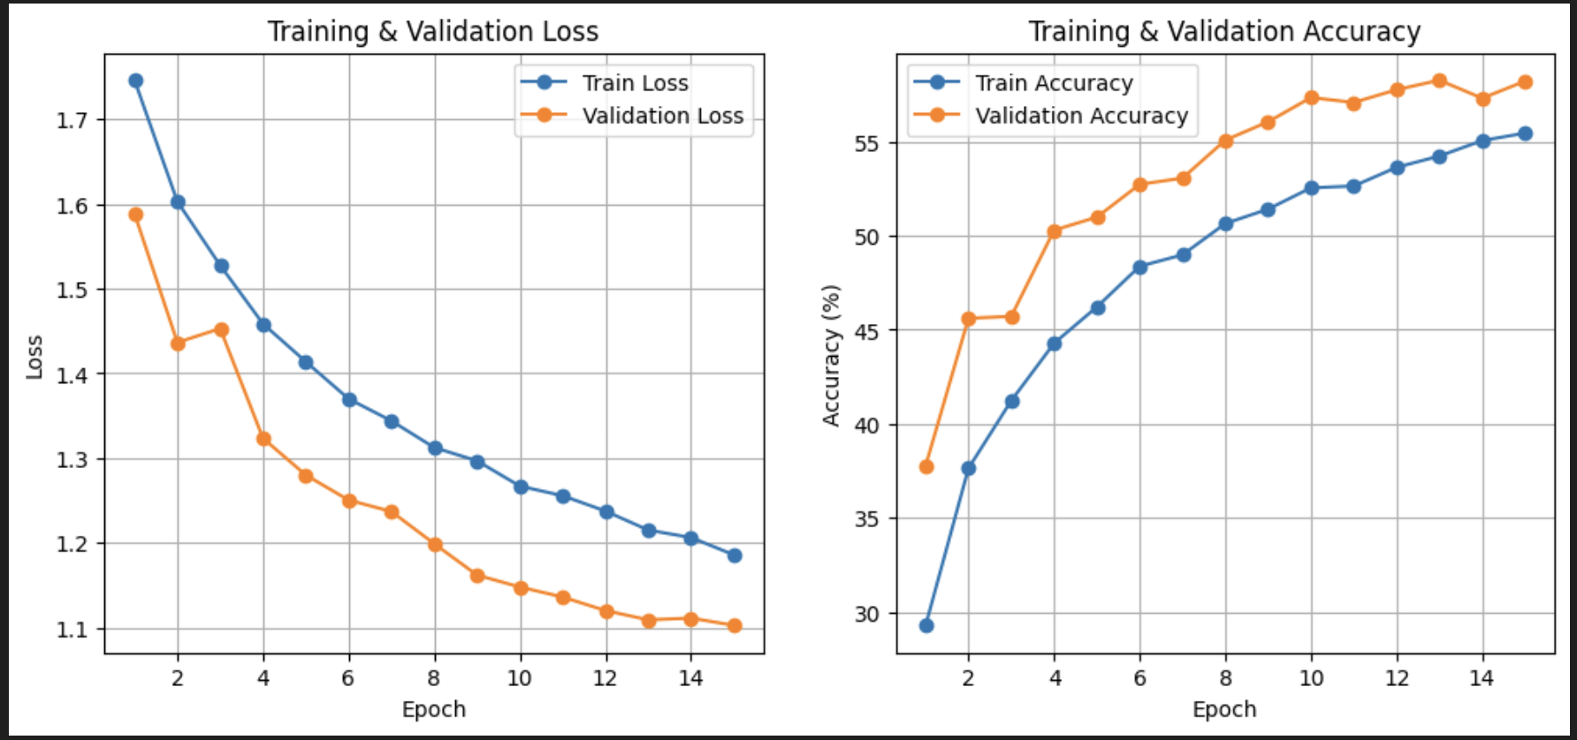
Facial Expression ResNet-18 Performance
Notes:
Xiao

Slide 14
Facial Expression Model Summary
Accuracy variation across emotions suggests a dataset imbalance issue.
Certain emotions are easier to classify, while others are more challenging due to their subtle differences.
Easy: Happy, Surprise, Neutral (distinct features, well-represented in training data).
Hard: Fear, Disgust, Angry (subtle expressions, fewer training samples).
Notes:
Xiao

Slide 15
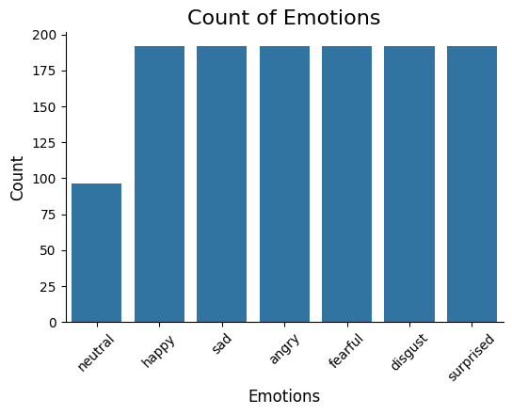
Emotional Speech Model EDA
Data source: RAVDESS emotional speech dataset (kaggle)
Data format: 1440 wav files with 7 different emotions
Phrases: “Kids are talking by the door” and “Dogs are sitting by the door”
 | Total | Angry | Disgust | Fear | Happy | Neutral | Sad | Surprise
Train | 798 | 124 | 125 | 124 | 118 | 66 | 130 | 111
Val | 200 | 26 | 32 | 33 | 35 | 16 | 30 | 28
Test | 250 | 42 | 35 | 35 | 39 | 14 | 32 | 53
Notes:
Tushar

Slide 16
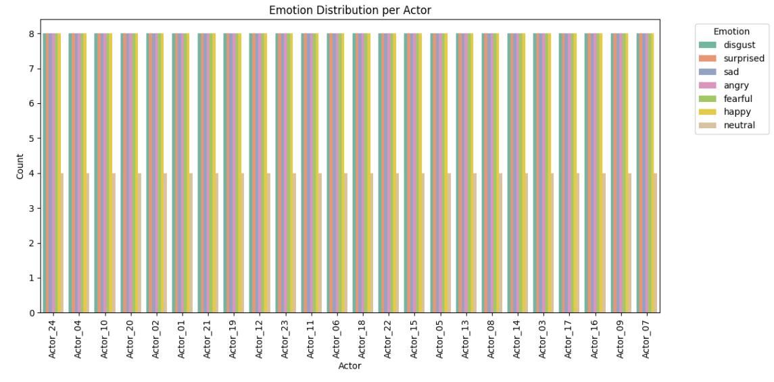
Emotional Speech Model EDA
Notes:
Tushar

Slide 17
Speech Feature Extraction and Augmentation
Librosa
Audio feature extraction package
156 total features extracted from spectral features
3 data augments (noise, pitch, stretch)
Spectral features | Description
chroma_stft | Compute a chromagram from a waveform or power spectrogram
mfcc | Mel-frequency cepstral coefficients (MFCCs)
rms | Compute root-mean-square (RMS) value for each frame, either from the audio samples y or from a spectrogram S
melspectrogram | Compute a mel-scaled spectrogram
spectral_centroid | Compute the spectral centroid
spectral_rolloff | Compute roll-off frequency
Notes:
Tushar
MFCCs (Mel Frequency Cepstral Coefficients)
Why? MFCCs capture the timbral (tone quality) aspects of audio, which are crucial for identifying emotions. Variations in pitch, tone, and vocal tract shape (all reflected in MFCCs) often change with emotional state.
Tip: Extract multiple MFCCs (typically 13–40 coefficients) and consider their delta (rate of change) and delta-delta (acceleration) to capture temporal dynamics.
Chroma Vector
Why? Emotions can influence pitch usage and harmonic content. Chroma vectors represent pitch class information, which is useful for identifying tonal characteristics influenced by emotion (like higher pitch in excitement or lower pitch in sadness).
Spectral Centroid
Why? This reflects the "brightness" of the sound. Emotions like anger or excitement can push energy towards higher frequencies, while sadness may result in a lower centroid.
Spectral Flux
Why? Measures how quickly the power spectrum changes. Emotional speech often has more dynamic changes (like in surprise or anger), making this feature useful.
Energy
Why? Emotions strongly influence the loudness of speech. For instance, anger or joy is typically louder, while sadness is quieter.
Entropy of Energy
Why? Captures the abruptness and variability in energy. Excited or angry speech might show more variability compared to calm, neutral speech.
Spectral Rolloff
Why? Helps determine the skewness of the spectrum. High-energy emotions like anger may result in higher rolloff frequencies.

Slide 18
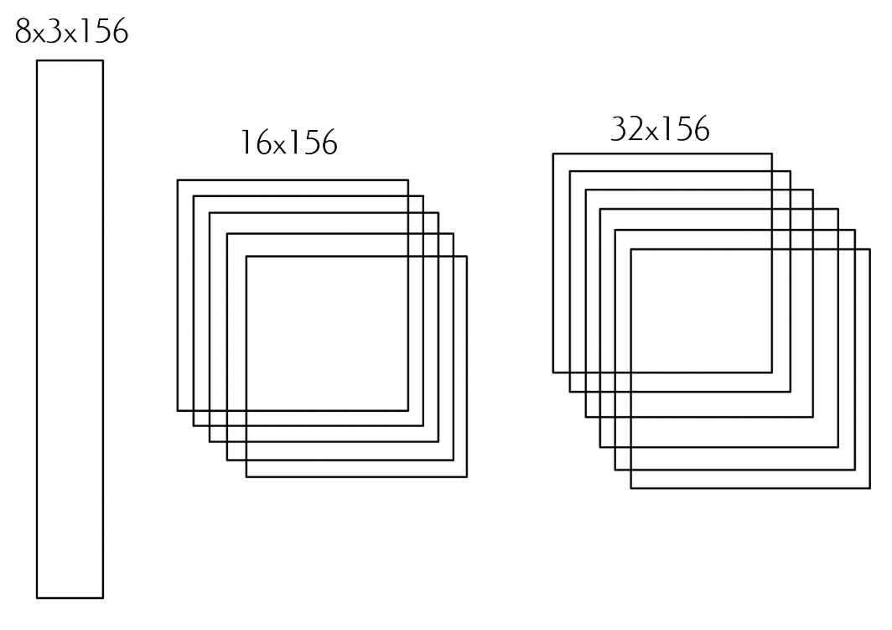
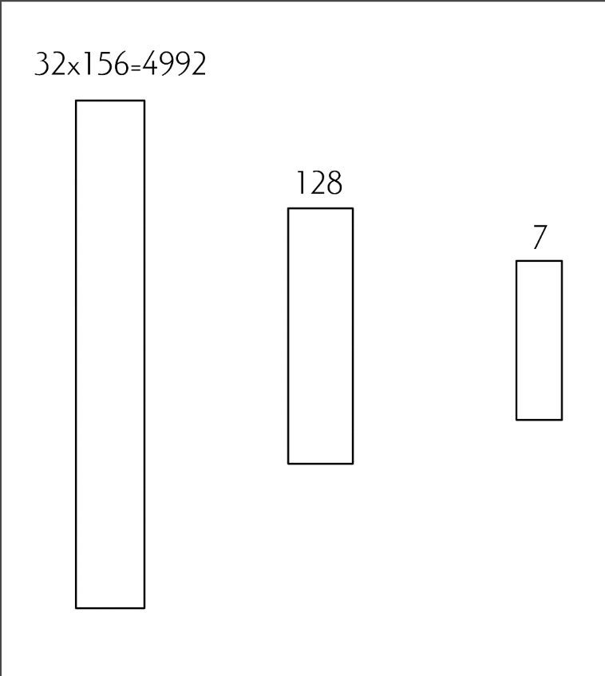
Emotional Speech Model Structure
8 batches & 100 epochs
1 Dimensional CNN into fully connected network
ReLU in each step
Notes:
Isaac
Our model collects 8 batches and is run over 100 epochs. Each batch is fed into a 1 dimensional CNN, having the first 3 augmentations projected into 16, then 32 augmentations with 156 features each. It is then flattened into a 4992 length fully connected neural network, which lowers the output to 128, then to 7 with ReLU in each step to introduce non-linearity into the model. Even though this is simple, it worked the best for us. Tushar will explain the other models that we went through later.

Slide 19
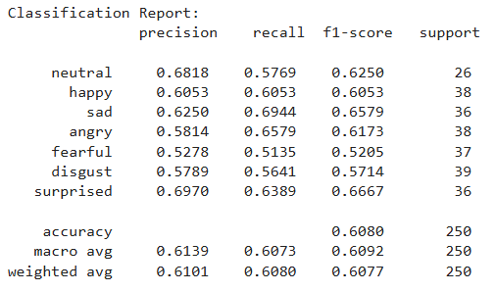
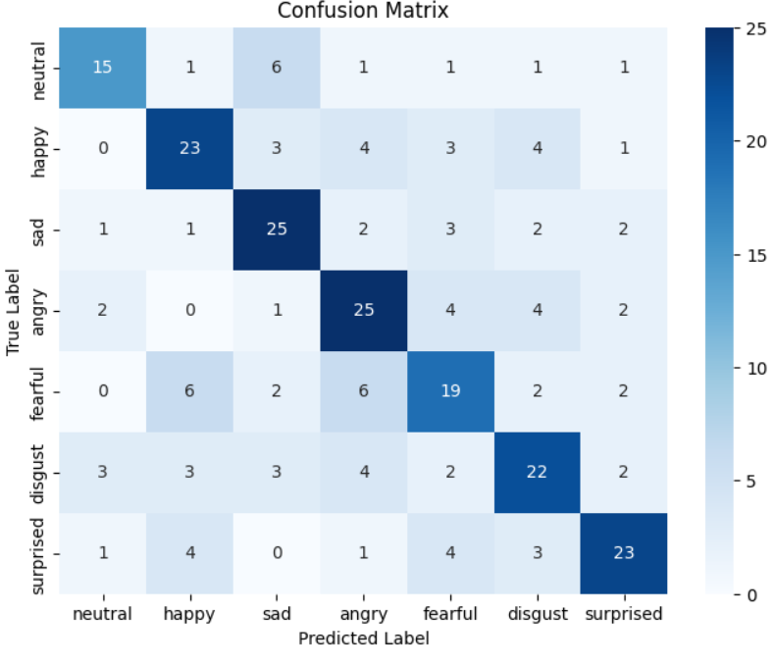
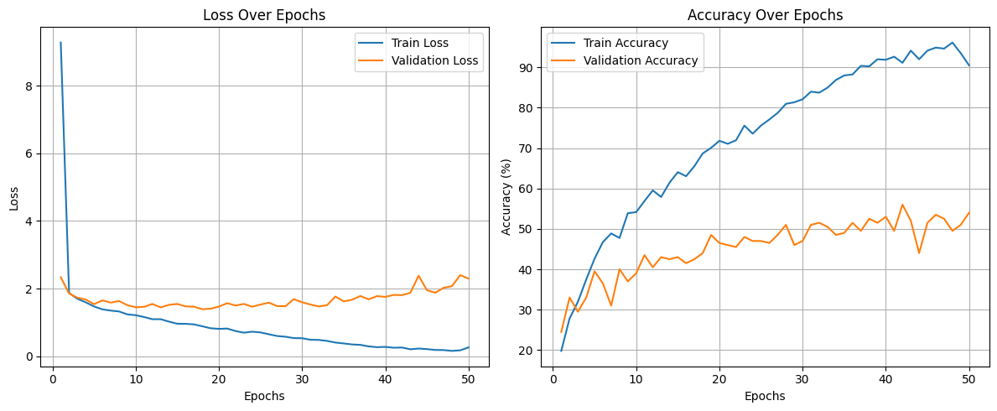
Emotional Speech Model Performance
Notes:
Isaac
By doing so, we obtained our most optimal model, with roughly 60% in every emotion except for fear. Although this is our best performing model, it is overfitting since our train accuracy is much higher than our validation accuracy, as seen by the loss curve and accuracy curves. Looking at our confusion matrix, we noticed that there is a good trend between the true and predicted labels. However, happy and angry were getting mixed up with fear, and sad was getting mistaken with neutral a lot.

Slide 20

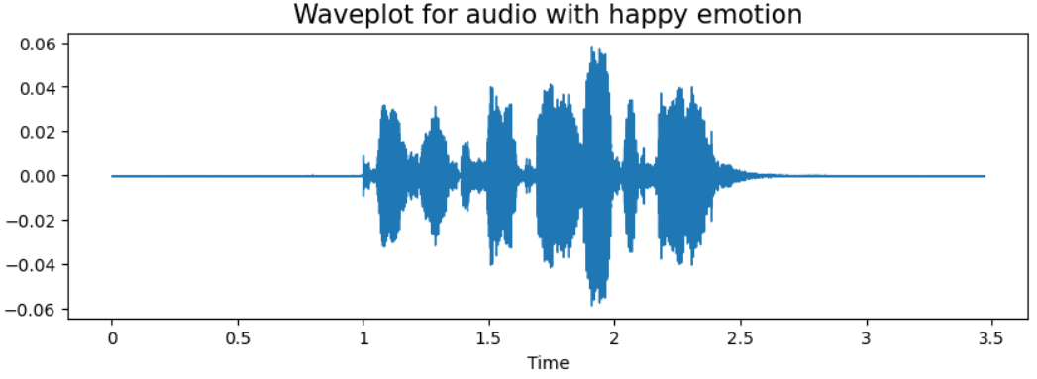
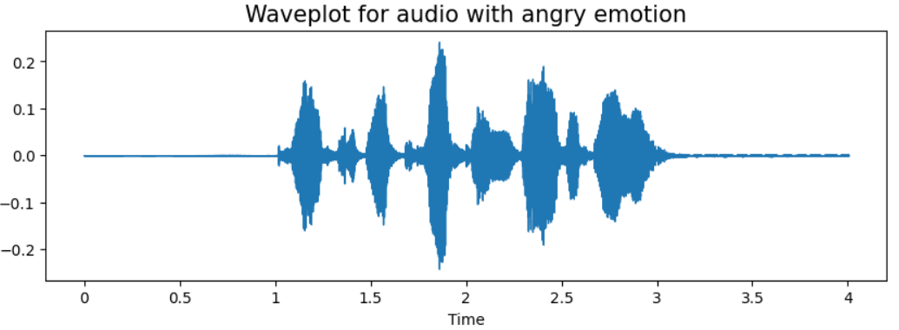
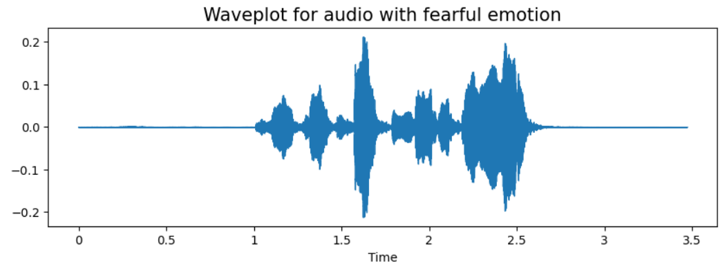
Emotional Speech Model Performance
Happy
Angry
Fearful
Waveform and Sound Analysis
Issue might be because these emotions are very similar without facial expression data and model is overfitting
Notes:
Isaac
We will now play a demo of some sound waves between happy, fear, and angry. We want the audience to vote to see which emotions they think these 3 are.
The issue behind our model might simply be because the emotions based on speech can be easily mistaken without facial expression data, and that our model is currently overfitting.

Slide 21
Final Results
Facial Emotion Recognition:
64% best model
Emotional Speech
61% best model
Happiness is the easiest emotion to classify
Fear is the hardest emotion to classify
Notes:
Isaac

Slide 22
Alternatives Explored
Facial Expression Model:
We experimented with two different CNN models and achieved similar results (~60% accuracy), which may indicate a limitation of the dataset itself rather than the model architecture.
The best reported accuracy on Kaggle is ~70%, suggesting that our current results are competitive but have room for improvement.
Tried using a pre-trained ResNet-18 model, the results were similar.
Emotional Speech Model:
Incorporated 3 additional datasets (~11970 data points)
More complex architectures and model types
Regularization techniques made performance worse
No augmentation
Notes:
First half: Shiyang
Second half: Tushar

Slide 23
Additional models that performed better
FER: Huang ZY et. al (2023)
77.37% accuracy
But bad external validation scores
Speech emotion recognition: Asmaa Samir (2023)
97.25% accuracy
Possible data leakage into model
Emotion classification: Marco Giuseppe de Pinto (2020)
80% accuracy
Notes:
Isaac

Slide 24
Future Directions
Dataset selection
Dataset processing
More data for disgust
More hyperparameter combinations tested
Additional computational resources
AI agent
Extract Facial Emotion Data
Image Emotional Classifier
Video Source
Predicted Emotion
Extract Emotional Speech Data
Audio Emotional Classifier
Notes:
Xiao

Slide 25
THANKS!
Questions?

